Slide 1

ALICE-Juniors Meeting
4 December 2017
Basics of Git and ALICE Software
Shyam Kumar
[Junior Representative of ALICE-India Group]
Department of Physics, IIT Bombay, Mumbai
Email: shyam055119@gmail.com

Slide 2
Outline
Why Git ?
Git from Commands and Manual
Committing the code (Manual)
Basics of ALICE Software
Adding Class in ALIROOT
Summary

Slide 3
Why Git ?
Google Drive
Git Repository
Uploading a file and replacing
Uploading a file and replacing
No history of files very hard to find changes
Complete history of files
PMD
Not Good for cases When many Peoples
are working on common Project
Very helpful When many Peoples
are working on common Project
Example

Slide 4
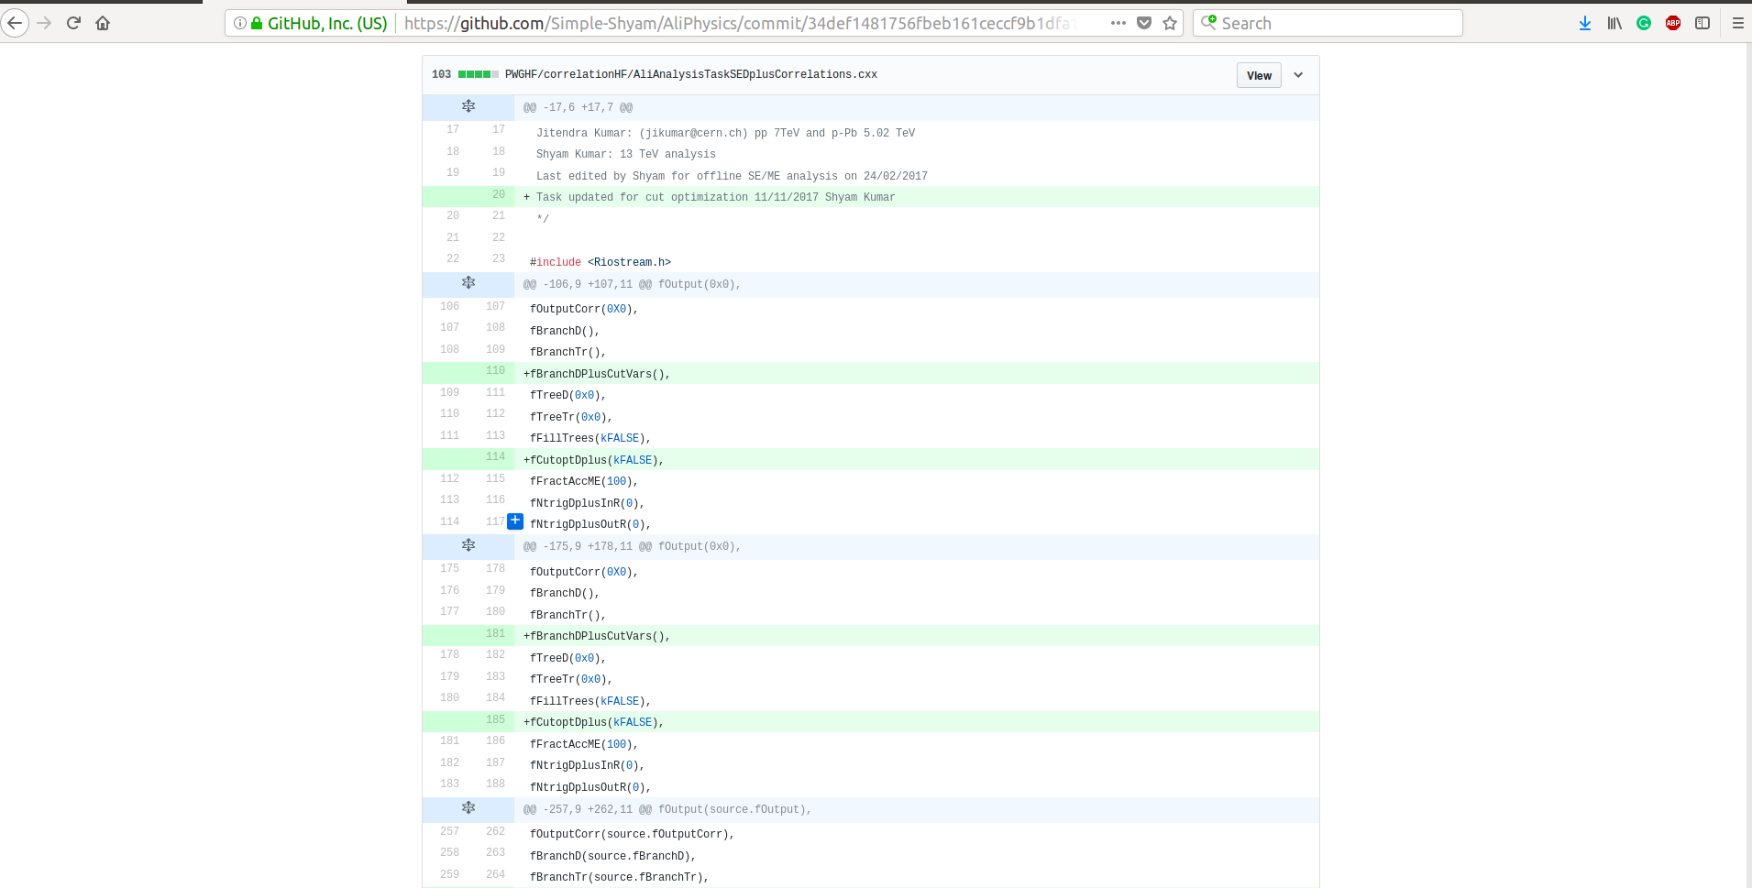
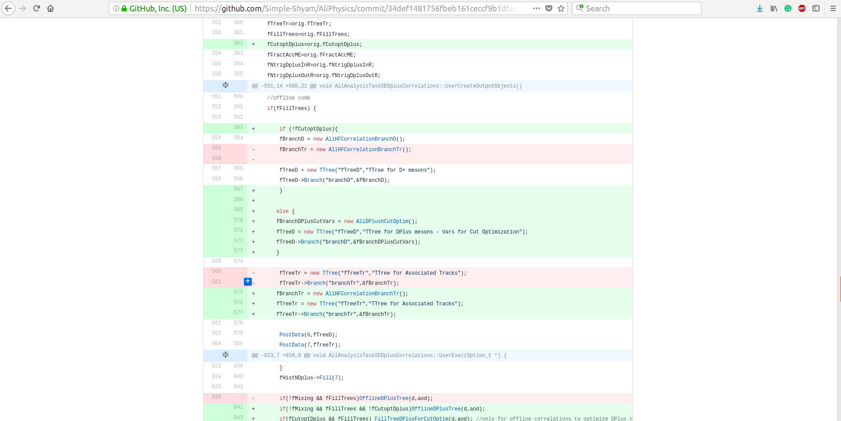
My Latest committed class
Red (-ve ) : Removed lines
Green (+ve ): Added lines
Git Repository (Good Job)

Slide 5
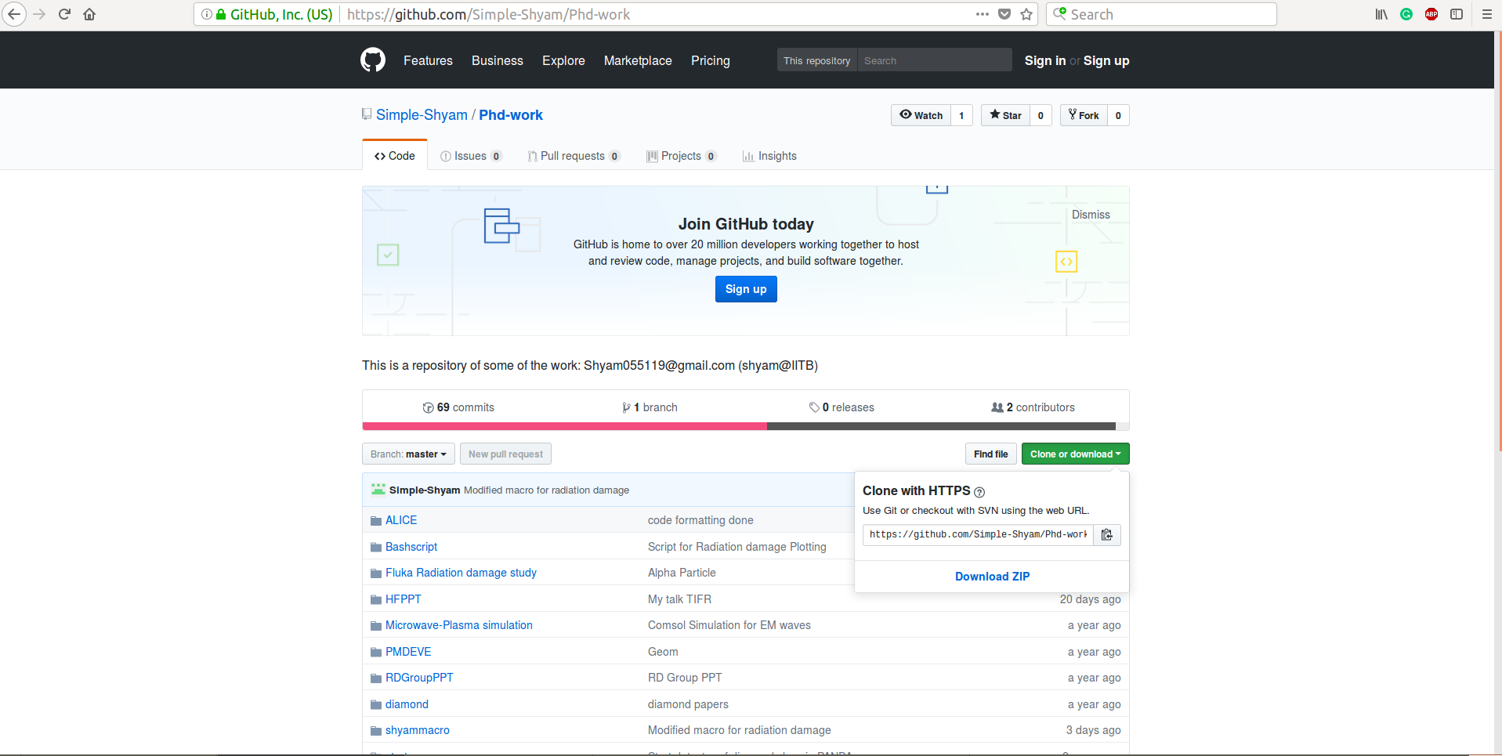
Git from Commands and Manual
Your Git use name
Login here and Fork
git clone path
git clone https://...... (It will download and extract both) [Command line]
Download Zip: Tar file then just extract [Manual]

Slide 6
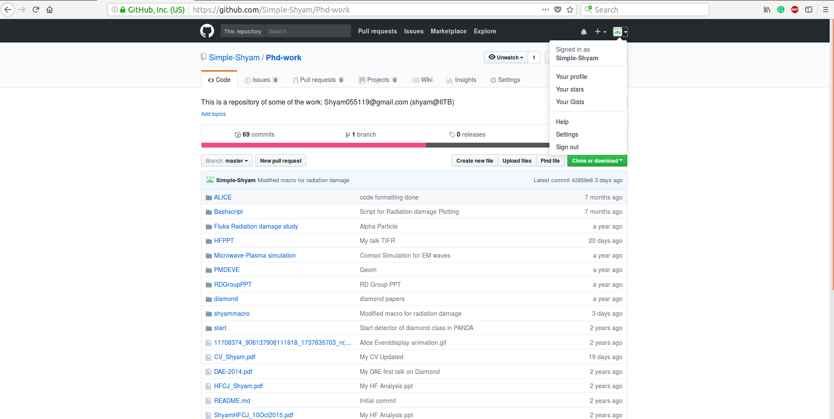
After Login

Slide 7
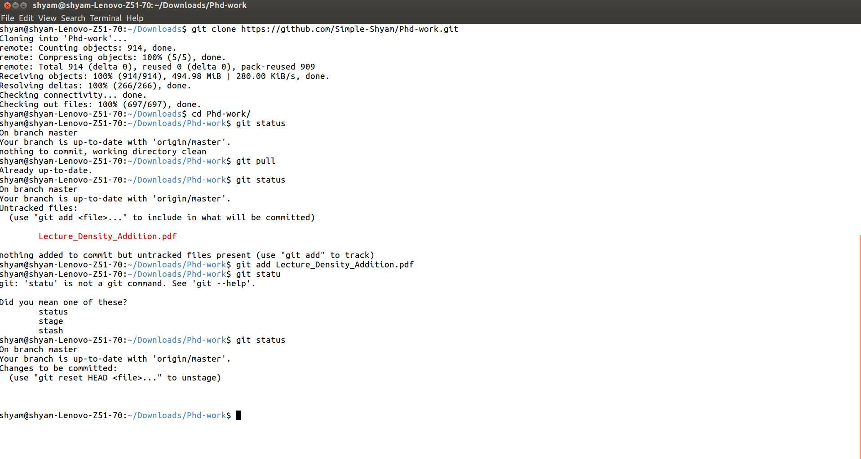
Cloning
Check the status always
Download changes
Added a file Lecture…. In PhD work but not in repository
Added a file Lecture….

Slide 8
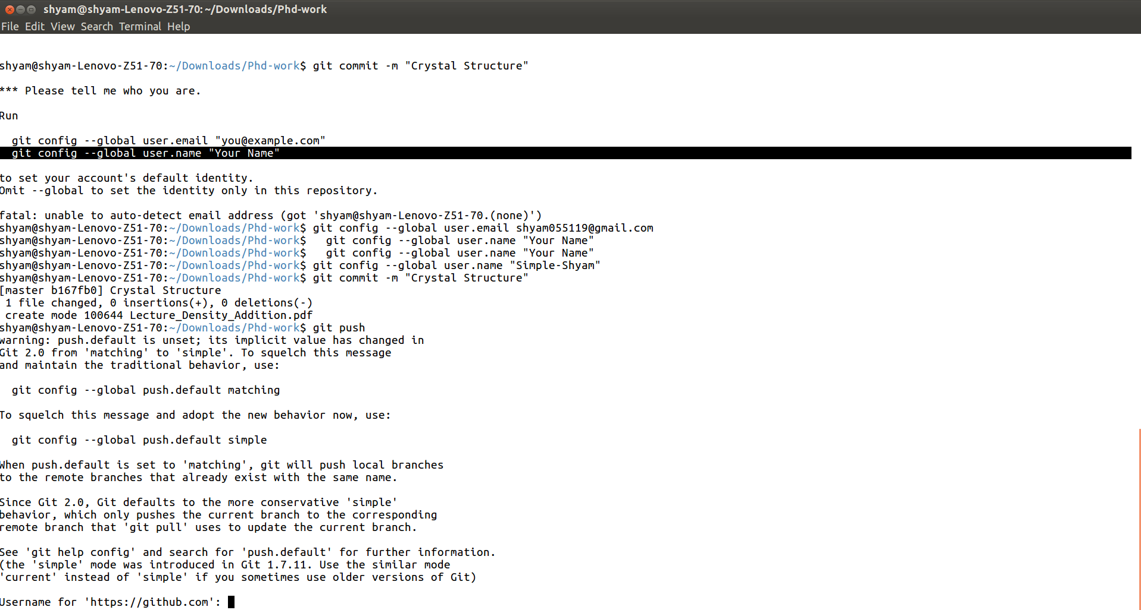
After adding tried to commit
Configure username and mail id
Push the changes on repository
User name : Simple-Shyam
Next line is password enter this will push the changes

Slide 9
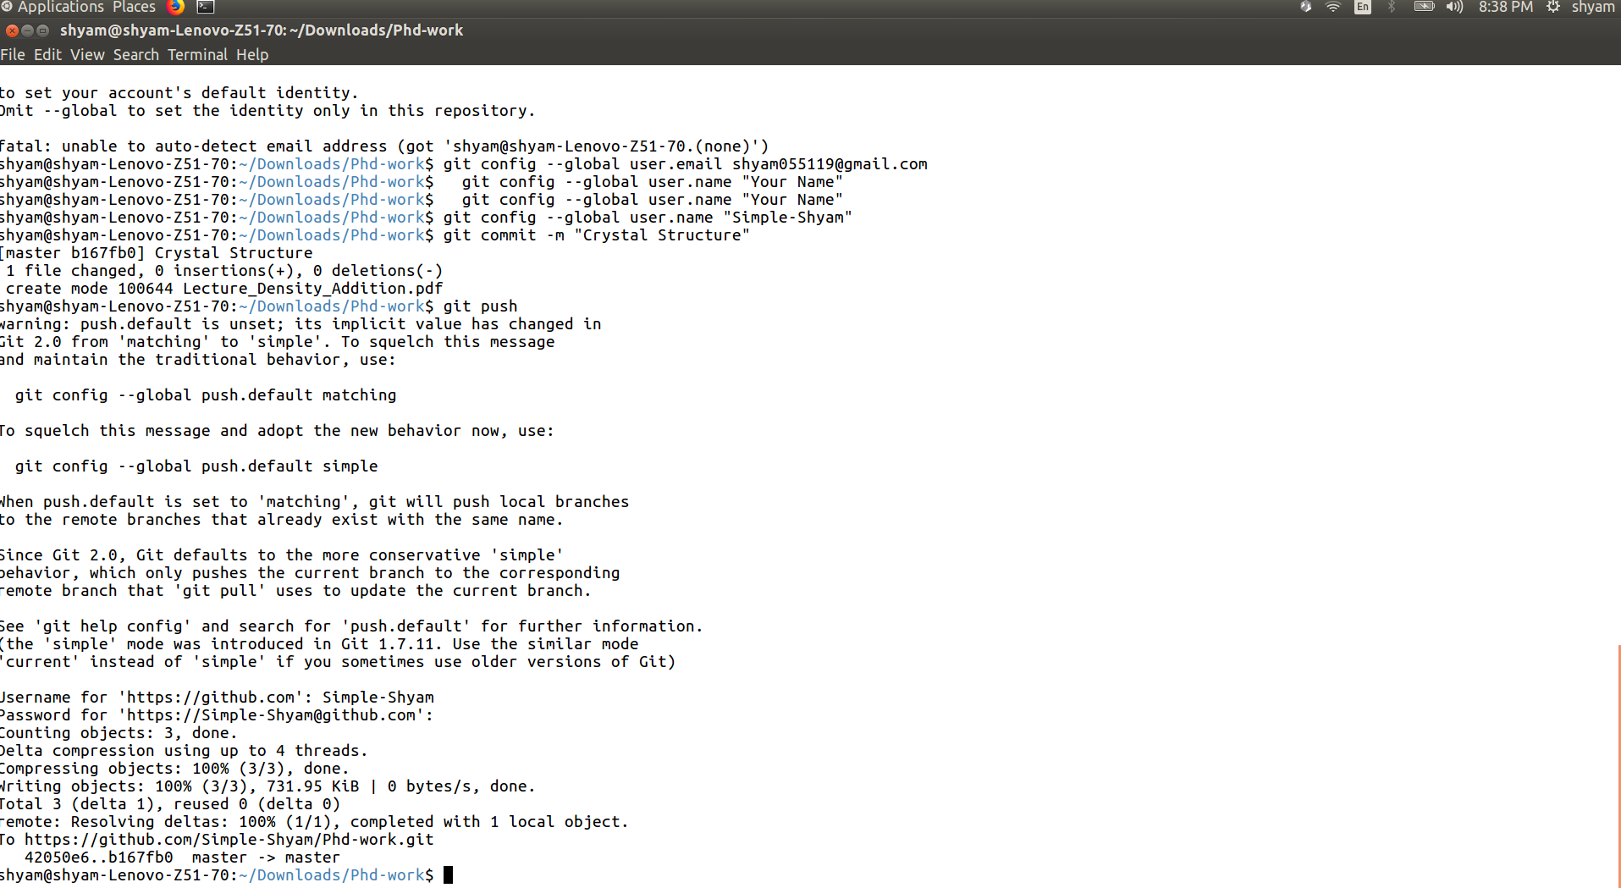
Previous Steps

Slide 10
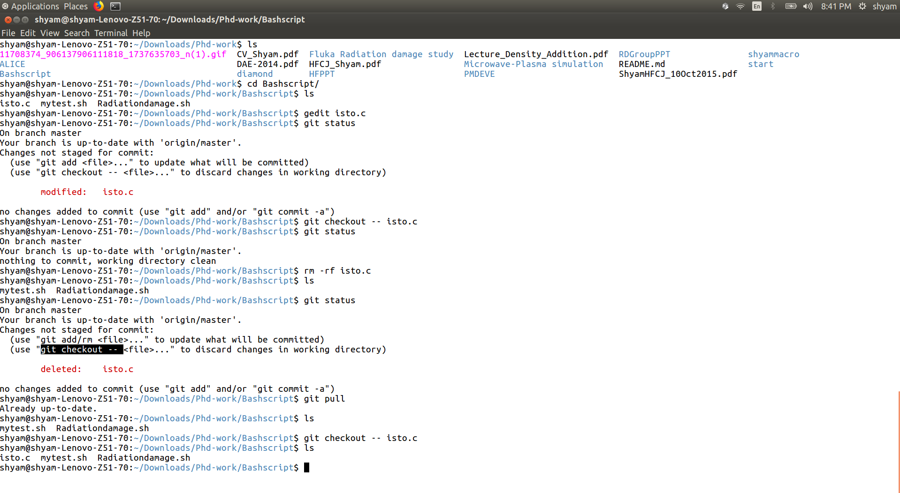
Done changes in isto.c in my desktop not in repository (Some time you modified aliroot class)
Do un-changes in code

Slide 11
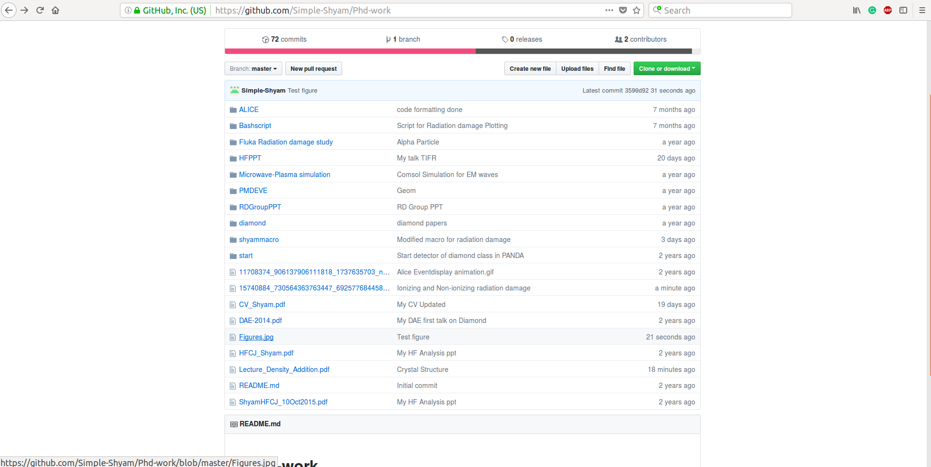
Manually committing (No commands)
Upload file

Slide 12
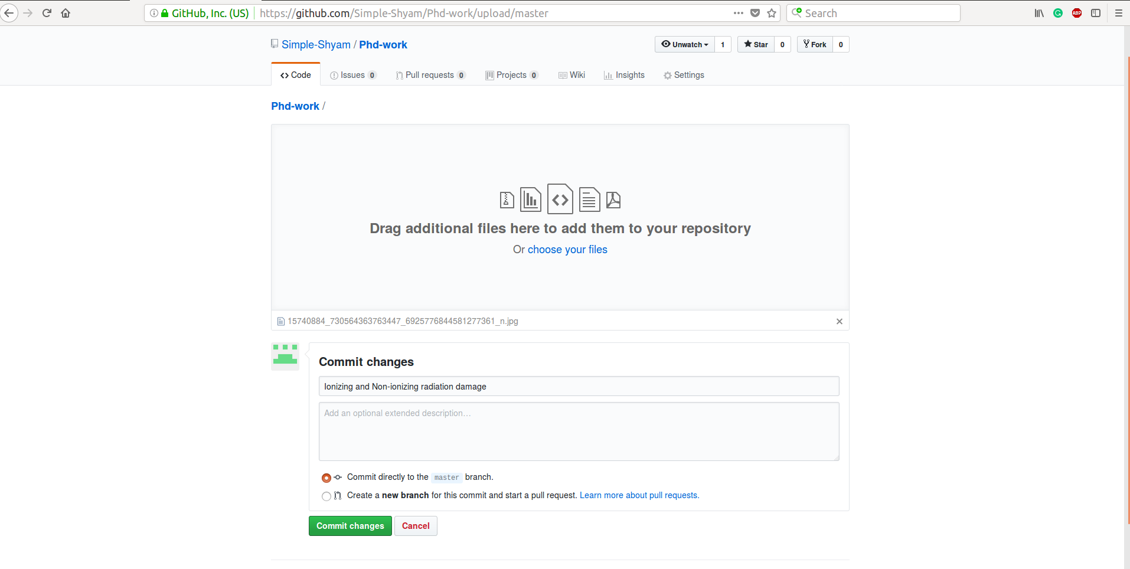
Upload files as we do normally
Put the message in this line related to file
Click on commit changes (Very simple) done !!!!!

Slide 13
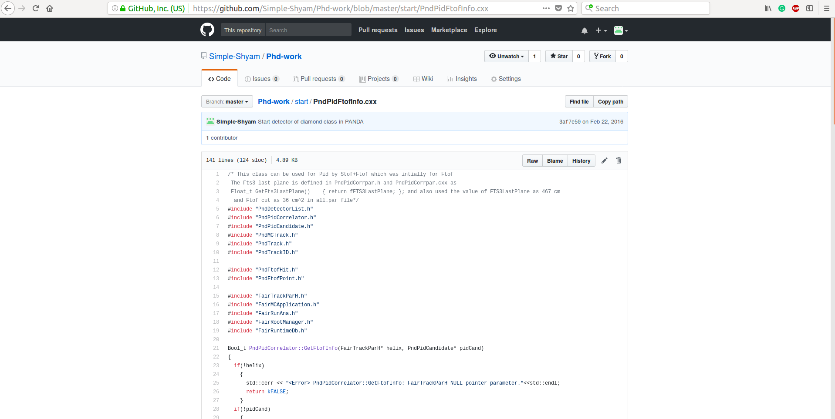
You can also look at the history
Delete a file if wrongly committed (Edit of delete)

Slide 14
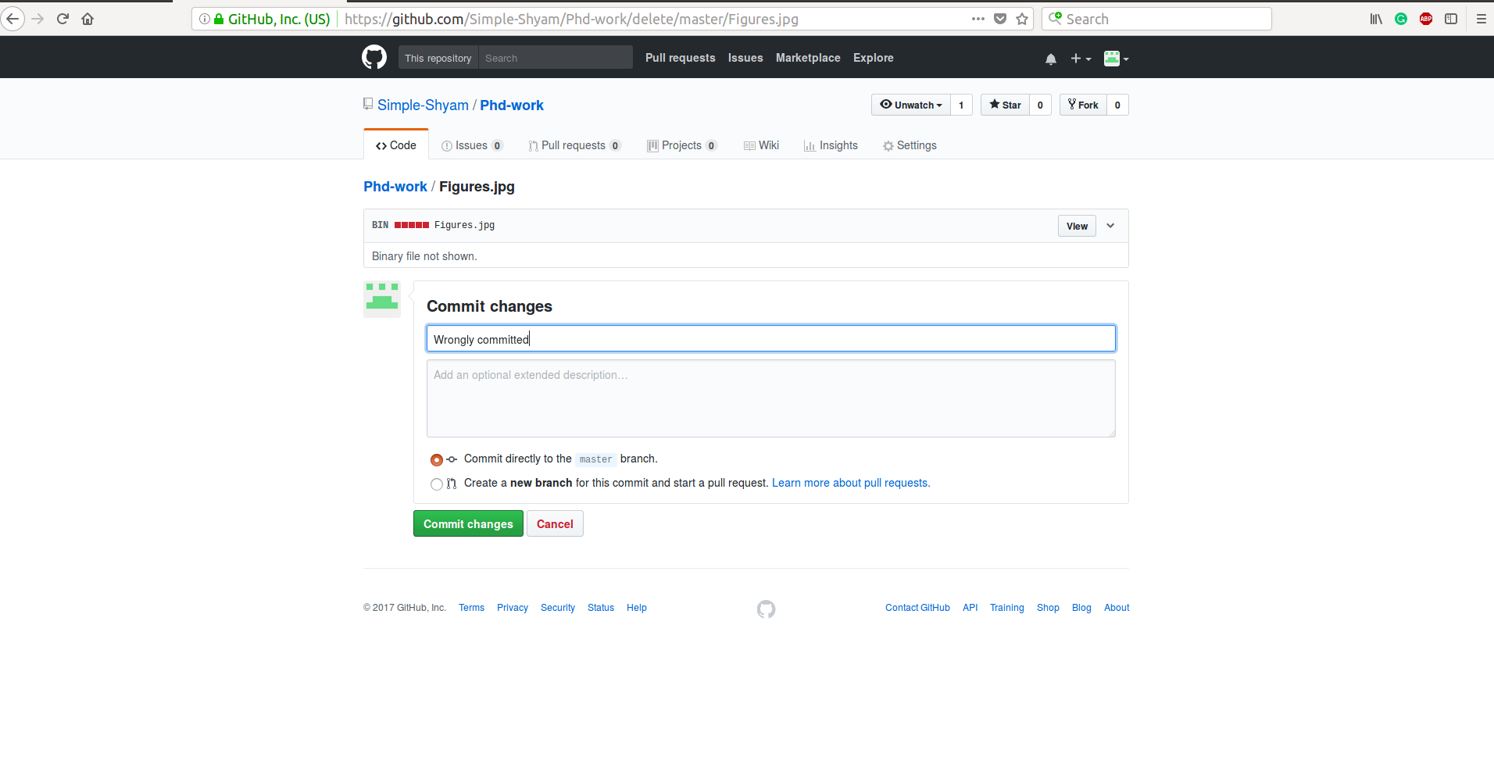
For deleting again require commit changes put messages

Slide 15
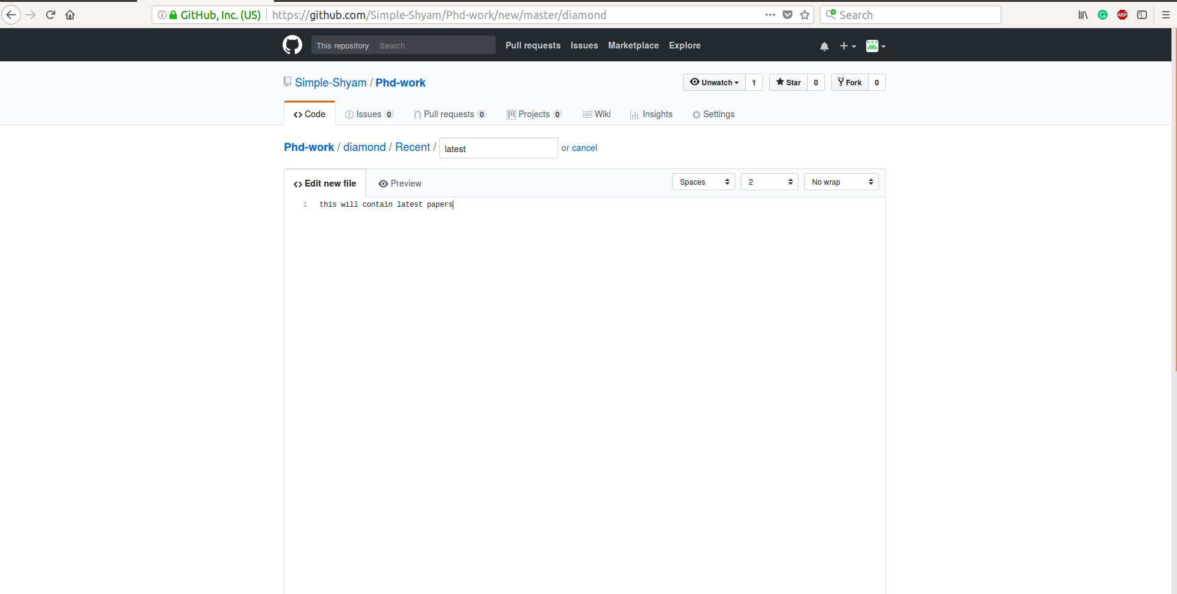
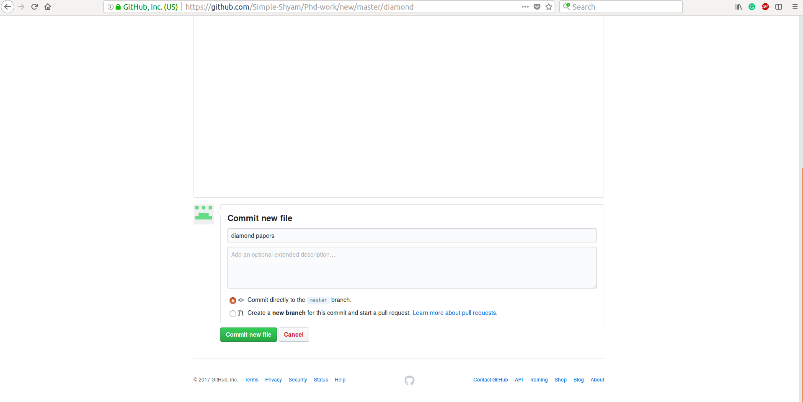
Adding a directory

Slide 16
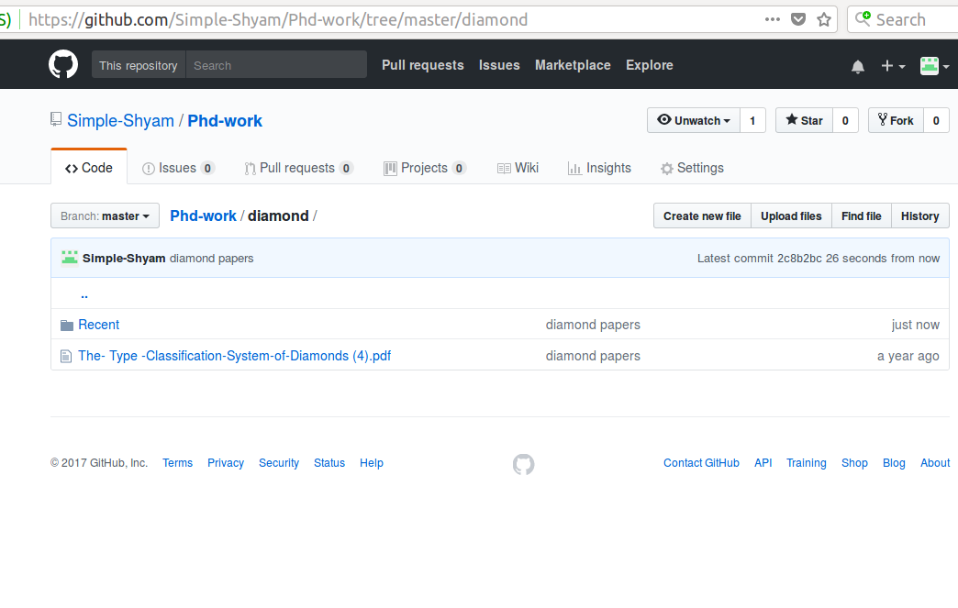
Created directory now you can upload files

Slide 17
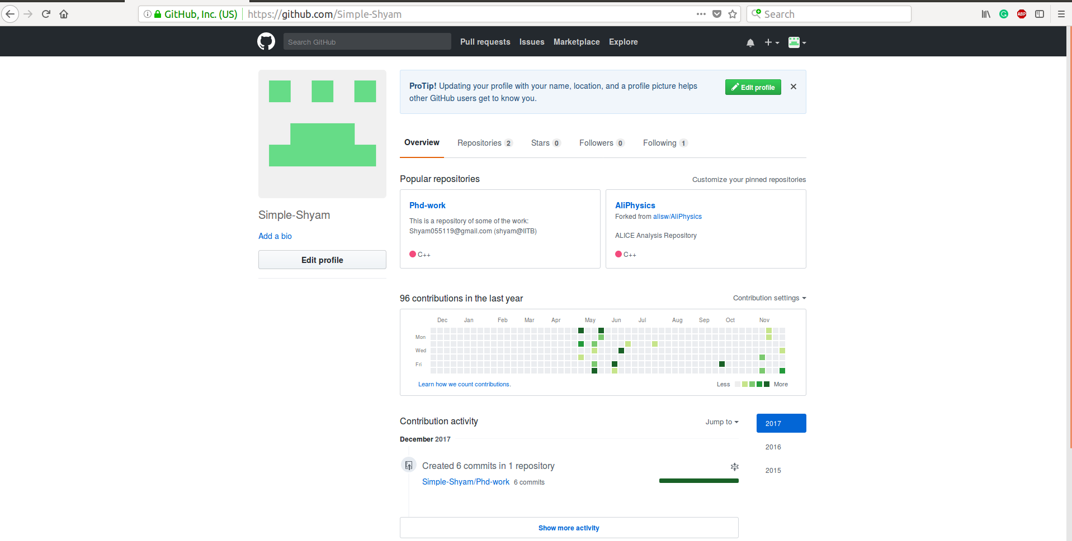
Committing the code (Manual)
Forked repository

Slide 18
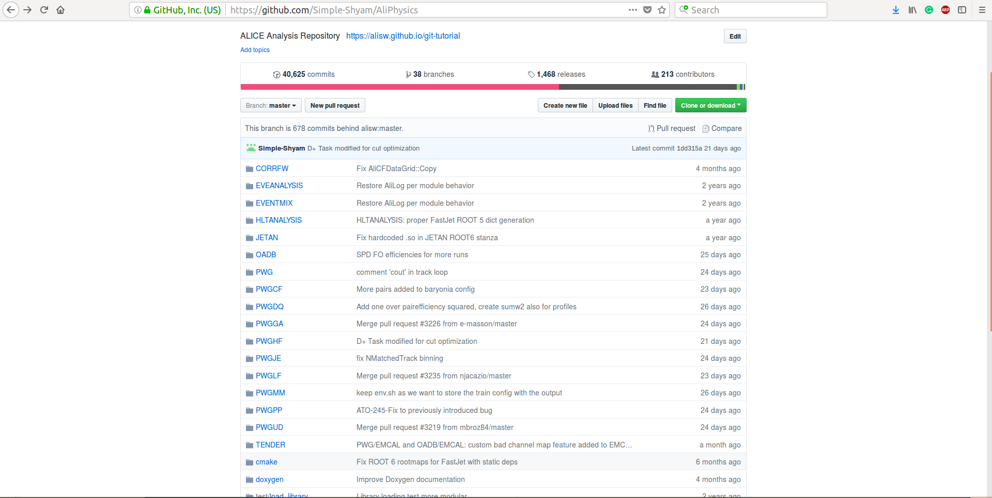
Forked repository

Slide 19
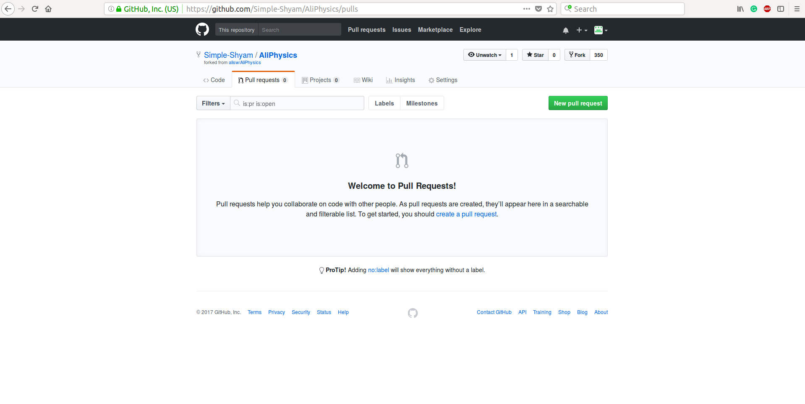
After uploading your code just make pull request convener will approve then It will be in AliRoot/AliPhysics [ I have always done like this]

Slide 20
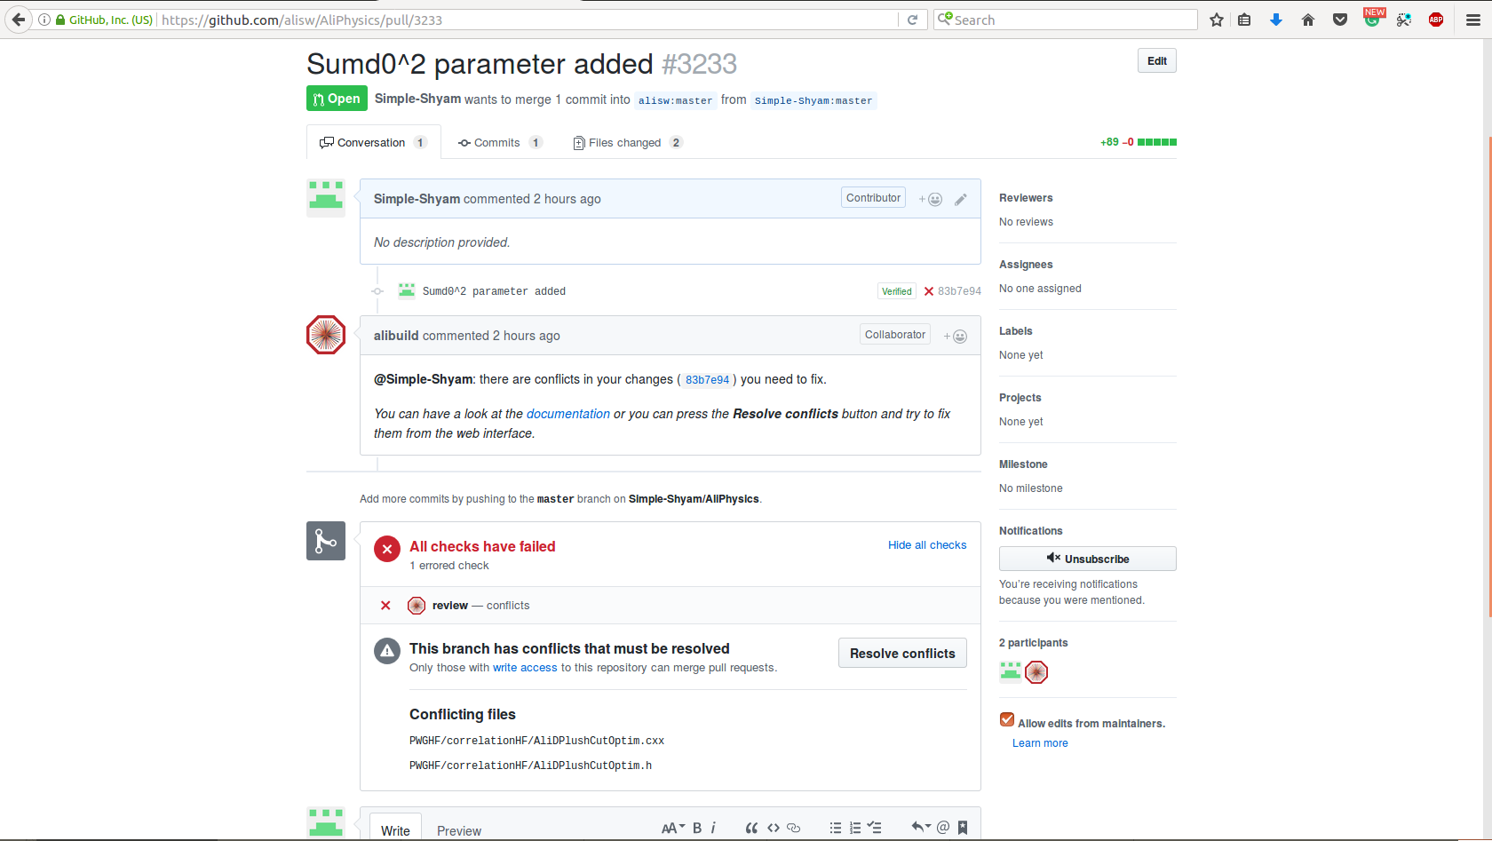
Conflict came: Click on resolve conflicts (solved my case)

Slide 21
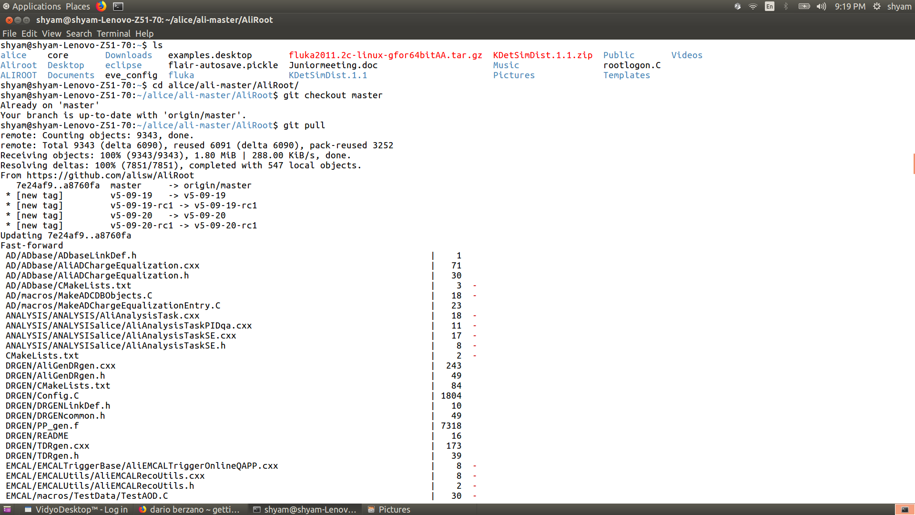
Basics of ALICE Software
Go into the AliRoot directory, and do: git fetch --all git reset --hard v5-09-20 You can proceed with aliBuild normally.

Slide 22
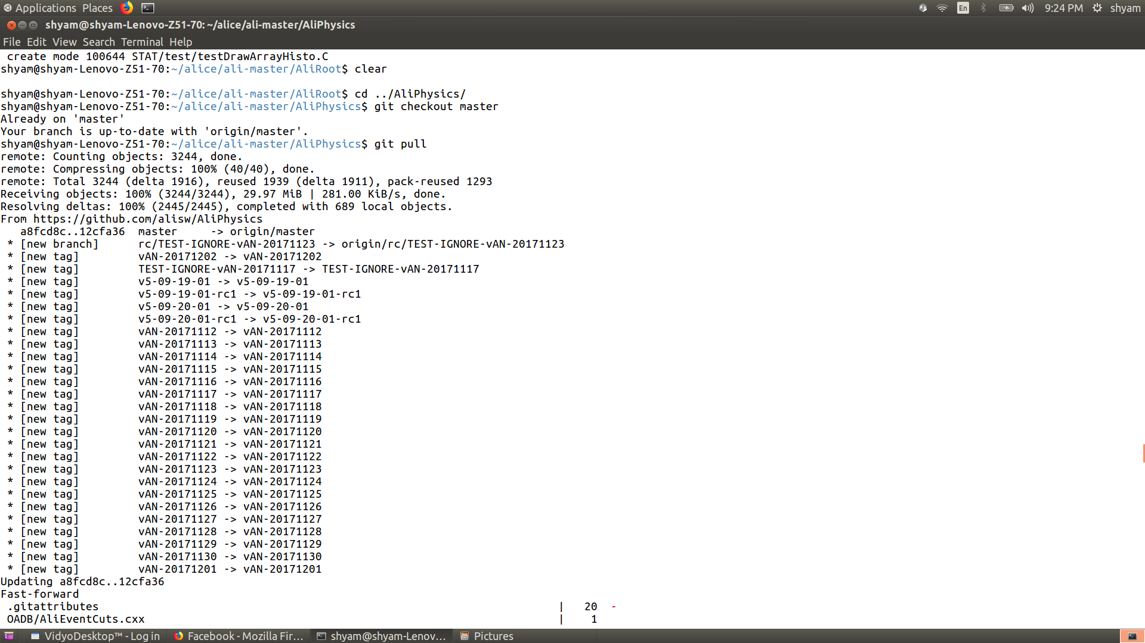
Update AliPhysics
Always check git status
It will tell if some files are modified, It can create problem in building

Slide 23
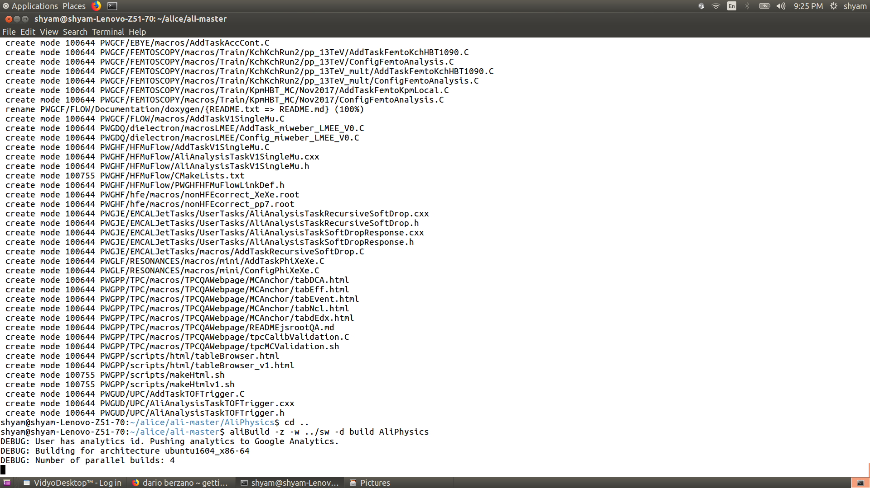
Finally run the command below in the specified directory and follow instruction

Slide 24
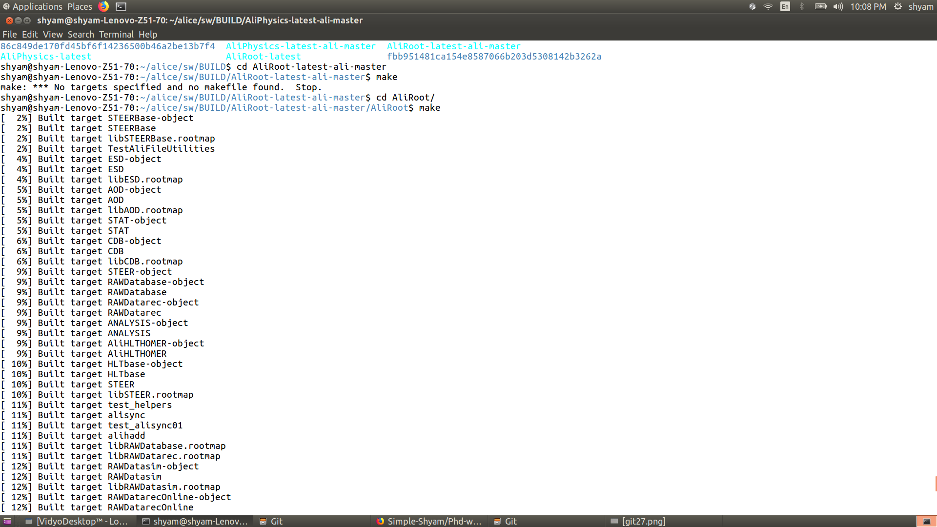
You can build on this path also [AliRoot]
What Exactly make do ????

Slide 25
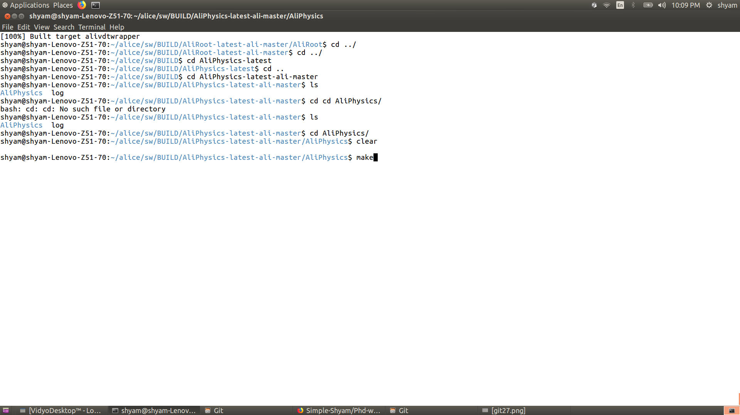
You can build on this path also [AliPhysics]
How #include “example.h” works in classes we never give the path? ??
example.h can be anywhere.

Slide 26
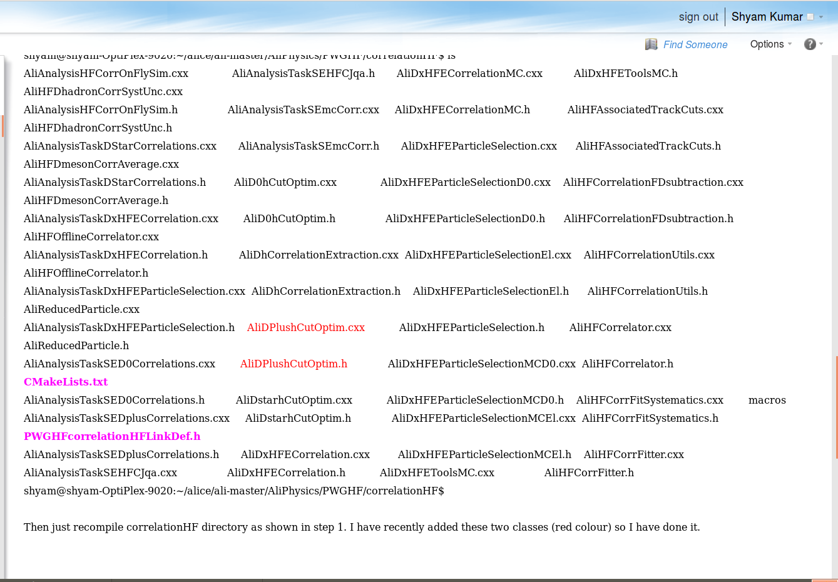
Adding Class in ALIROOT

Slide 27
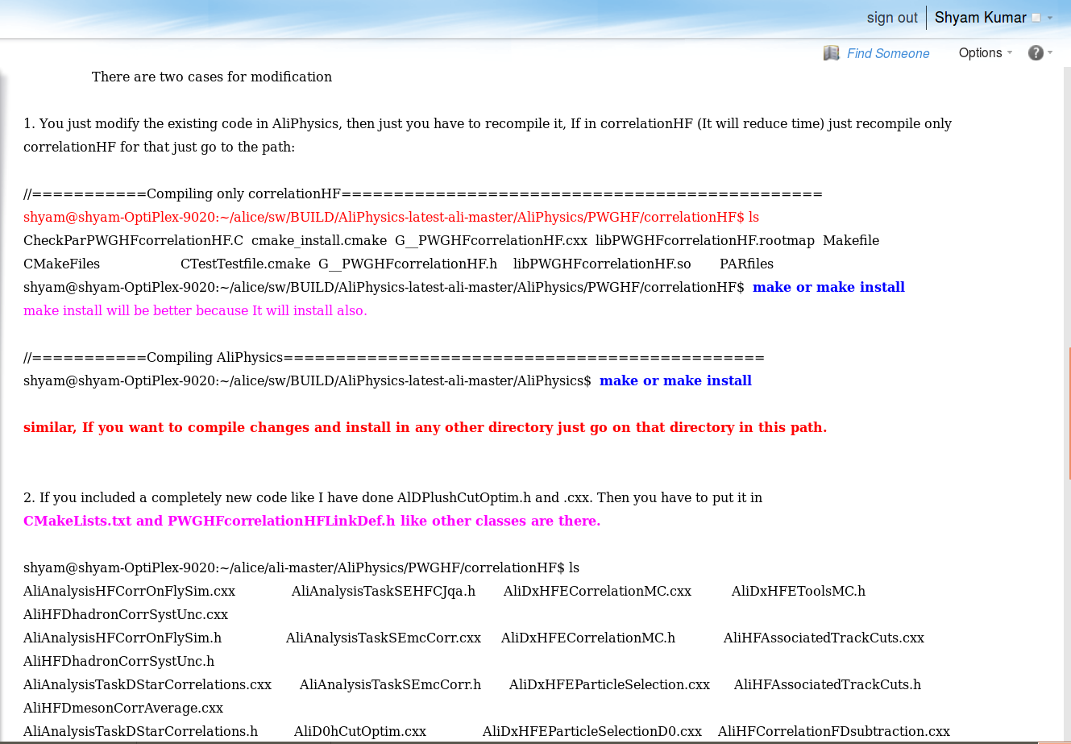
You can build also specified directory [correlationHF]

Slide 28
Summary
Play with Git commands as much as you can on your local repository !!!!!
Try Other git commands on your repository given in link below
https://confluence.atlassian.com/bitbucketserver/basic-git-commands-776639767.html
Thank You

